Slide 1
Overcoming Spiritual Discouragement
Textual Study of I Kings 19:1-18
Notes:
This story does not apply directly to us. We are not prophets, and God does not speak directly to us. However, we can learn a few points about God's patient nature, man's weak nature, and God's expectations for us.

Slide 2
The Pretext
And Elijah came to all the people, and said, “How long will you falter between two opinions? If the LORD is God, follow Him; but if Baal, follow him.” But the people answered him not a word. Then Elijah said to the people, “I alone am left a prophet of the LORD; but Baal’s prophets are four hundred and fifty men. Therefore let them give us two bulls; and let them choose one bull for themselves, cut it in pieces, and lay it on the wood, but put no fire under it; and I will prepare the other bull, and lay it on the wood, but put no fire under it. Then you call on the name of your gods, and I will call on the name of the LORD; and the God who answers by fire, He is God.” So all the people answered and said, “It is well spoken.” (I Kings 18:21-24)
Notes:
Notice the indecisive and unconvicted response of the people. Nobody would stand up for the Lord and with Elijah, if there was even anybody inclined to stand up.
Elijah was badly outnumbered by the established, supported prophets of Baal.
A miracle was required to show the true God, and all agreed that this was a reasonable test and therefore contest.

Slide 3
The Pretext
So they cried aloud, and cut themselves, as was their custom, with knives and lances, until the blood gushed out on them. And when midday was past, they prophesied until the time of the offering of the evening sacrifice. But there was no voice; no one answered, no one paid attention. (I Kings 18:28-29)
Then Elijah said to all the people, “Come near to me.” So all the people came near to him. And he repaired the altar of the LORD that was broken down. (I Kings 18:30) …
Notes:
The 450 prophets of Baal tried all day to make their god respond. Of course, there was no divine response, but eventually, even the people lost interest. The prophets of Baal had already been defeated.
The ruined condition of the Lord’s altar indicated how little attention and service it had received, if it had not been deliberately ruined.
Elijah had to begin just by repairing the altar.

Slide 4
The Pretext
… Elijah the prophet came near and said, “LORD God of Abraham, Isaac, and Israel, let it be known this day that You are God in Israel and I am Your servant, and that I have done all these things at Your word. Hear me, O LORD, hear me, that this people may know that You are the LORD God, and that You have turned their hearts back to You again.” Then the fire of the LORD fell and consumed the burnt sacrifice, and the wood and the stones and the dust, and it licked up the water that was in the trench. Now when all the people saw it, they fell on their faces; and they said, “The LORD, He is God! The LORD, He is God!” And Elijah said to them, “Seize the prophets of Baal! Do not let one of them escape!” So they seized them; and Elijah brought them down to the Brook Kishon and executed them there. … (I Kin. 18:36-40)
Notes:
Clearly, the Lord had instructed Elijah to do all of this. This contest had been arranged by Elijah, but God had prompted and outlined every step. The details of that revelation are lost to us, except as induced from Elijah’s actions.
The purpose of this demonstration was 3-fold: So, the people would know the Lord is the one true God; so, the people would know that Elijah was His prophet, which would reestablish his authority in spite of Jezebel’s and Ahab’s usurping; and all so, that the people would then repent sincerely and return to God.
There is no contest. Whereas the prophets of Ball could not generate 1 spark after a day spent in the most desperate of pleadings, the Lord God obliterated the sacrifice, the wood, the stone, the dust, and it even “licked up the water that was in the trench”! The failure of Baal was spectacularly unspectacular. The answer from God was overwhelming. The contrast should have been unforgettable.
The people respond immediately. Nobody (except maybe Jezebel) can deny such undeniable proofs.
The people support Elijah in observing the law and executing the false prophets among them.
It was an unequaled victory in persuading the people and bringing them to repentance.
This is the image of John the Baptist. He also turned the people back to the Lord – not with great wonders, but with similarly great success.

Slide 5
Review: Pivotal Victory
Ahab and Jezebel killed almost all prophets of the Lord, except Elijah and some who were hidden (I Kings 18:3-13, 22).
Israelite people were largely idolatrous, uncaring, lethargic, or terrified (I Kings 18:7-14, 17-18, 21, 30).
After victory on Mt. Carmel, the tide turned (I Kings 18:38-40):
Israel acknowledged and “turned their hearts” to the true God!
Elijah had been established as a true prophet and servant of God.
The 450 prophets of Baal – supported by Jezebel – were destroyed.
Even Ahab was somewhat compliant (I Kings 18:41-42).
Elijah prayed and ended a 3-year drought (I Kings 17:1; 18:42-44).
God’s presence and dominance had been overwhelmingly expressed.

Slide 6
Enter the Dragon
And Ahab told Jezebel all that Elijah had done, also how he had executed all the prophets with the sword. Then Jezebel sent a messenger to Elijah, saying, “So let the gods do to me, and more also, if I do not make your life as the life of one of them by tomorrow about this time.” (19:1-2)
Do you ever feel spiritually discouraged or even depressed?
Do you ever have fantastic days that crash into disaster?
Does life fail to match expectations? Dreams dashed?
Do people in whom you believed or trusted, disappoint you?
Do we feel God has forgotten us or abandoned us?
Like Elijah, our lives may change abruptly - victory to defeat!
Notes:
Clearly, Jezebel was the head monster in that marriage. Ahab never threatened Elijah. In fact, he submitted to his instruction to return home ahead of the storm (18:41-45). Although wholly compromised and evil, Ahab still knew he had been defeated. Jezebel must have been wholly committed to her wickedness to respond to defeat with such anger and threatening. There was not one ounce of righteousness, humility, or doubt within her.

Slide 7
“You think that’s bad!?”
Our struggles are not unique to us (I Corinthians 10:13).
Jesus was tempted like us, sympathizes with us (Heb. 4:15-16).
Jesus knew agony and struggle (Isa. 53:3-4; Mat. 26:36-44).
Elijah was like us, “a man subject to like passion” (James 5:17-18).
Victoriously opposed most wicked king of Israel’s history.
Honored to not see death (II Kings 2:1-2).
Figure for John the Baptist (Mal. 4:5-6; Mat. 11:2-14; 17:10-13).
Represented all prophets at Jesus’ transfiguration (Mat. 17:2-5).
Yet, he gave into discouragement, was corrected, and overcame!
Comfort and strength to overcome here, if willing (Rom. 15:4).
Must not let pride or selfishness keep us from God’s grace.

Slide 8
Descent into Despair
And when he saw that, he arose and ran for his life, and went to Beersheba, which belongs to Judah, and left his servant there. But he himself went a day’s journey into the wilderness, and came and sat down under a broom tree. And he prayed that he might die, and said, “It is enough! Now, LORD, take my life, for I am no better than my fathers!” (19:3-4)
Elijah believed that he had completely failed, ministry finished!
He thought he suffered enough, he had enough failures.
Yet, he did not really want death, because he “ran for his life”!
Note: Actions inconsistent with words often reveal true heart.
Notes:
Notice Elijah’s response: Sheer panic for survival! He ran for his life – for about 90 miles! Jezebel had already hewn down other prophets of the Lord. Why would Elijah expect special protection? Escape may seem reasonable to you and me, but remember, he went to Jezreel at the instruction and moving of the Lord! The Lord did not say he could leave. And, Elijah did not wait around to see what the Lord wanted him to do. Elijah left on his own prerogative, regardless of whatever intention the Lord may have had for him.
Elijah’s prayer and sentiment is overwhelmingly sorrowful. His extreme pain and disappointment with himself, his people, and his time are beyond evident. They can be felt in his words.

Slide 9
Who Determines “Enough”?
God sent him to Jezreel, but Elijah “ran for his life” (18:46; 19:3).
Elijah judged “it was enough”, but he was God’s servant!
God commissions start and stop of our work (II Kin. 13:14-19).
What if God commanded us serve like Paul (II Cor. 11:23-30)?

Slide 10
Paul, Bondservant of Jesus
Are they ministers of Christ? – I speak as a fool – I am more: in labors more abundant, in stripes above measure, in prisons more frequently, in deaths often. From the Jews five times I received forty stripes minus one. Three times I was beaten with rods; once I was stoned; three times I was shipwrecked; a night and a day I have been in the deep; in journeys often, in perils of waters, in perils of robbers, in perils of my own countrymen, in perils of the Gentiles, in perils in the city, in perils in the wilderness, in perils in the sea, in perils among false brethren; in weariness and toil, in sleeplessness often, in hunger and thirst, in fastings often, in cold and nakedness – besides the other things, what comes upon me daily: my deep concern for all the churches. (II Corinthians 11:23-28)

Slide 11
Who Determines “Enough”?
God sent him to Jezreel, but Elijah “ran for his life” (18:46; 19:3).
Elijah judged “it was enough”, but he was God’s servant!
God commissions start and stop of our work (II Kin. 13:14-19).
What if God commanded us serve like Paul (II Cor. 11:23-30)?
What if God commanded us serve like Jesus (Isaiah 53)?

Slide 12
Are We Greater than Jesus?
“If the world hates you, you know that it hated Me before it hated you. If you were of the world, the world would love its own. Yet because you are not of the world, but I chose you out of the world, therefore the world hates you. Remember the word that I said to you, ‘A servant is not greater than his master.’ If they persecuted Me, they will also persecute you. If they kept My word, they will keep yours also.” (John 15:18-20)
Can we dare expect to escape suffering, even though Jesus could not (Matthew 26:39-42) – and that innocently!?

Slide 13
Who Determines “Enough”?
God sent him to Jezreel, but Elijah “ran for his life” (18:46; 19:3).
Elijah judged “it was enough”, but he was God’s servant!
God commissions start and stop of our work (II Kin. 13:14-19).
What if God commanded us serve like Paul (II Cor. 11:23-30)?
What if God commanded us serve like Jesus (Isaiah 53)?
What if God commanded us serve like Job (James 5:11)?
What if God commanded us to serve, who are we to question?

Slide 14
Who Serves Who?
And the apostles said to the Lord, “Increase our faith.” So the Lord said, “… And which of you, having a servant plowing or tending sheep, will say to him when he has come in from the field, ‘Come at once and sit down to eat‘? But will he not rather say to him, ‘Prepare something for my supper, and gird yourself and serve me till I have eaten and drunk, and afterward you will eat and drink’? Does he thank that servant because he did the things that were commanded him? I think not. So likewise you, when you have done all those things which you are commanded, say, ‘We are unprofitable servants. We have done what was our duty to do.’” (Luke 17:5-10)

Slide 15
Who Determines “Enough”?
God sent him to Jezreel, but Elijah “ran for his life” (18:46; 19:3).
Elijah judged “it was enough”, but he was God’s servant!
God commissions start and stop of our work (II Kin. 13:14-19).
What if God commanded us serve like Paul (II Cor. 11:23-30)?
What if God commanded us serve like Jesus (Isaiah 53)?
What if God commanded us serve like Job (James 5:11)?
What if God commanded us to serve, who are we to question?
God cares for us, wants us to pray, and cast our cares on Him (I Pet. 5:7; Luke 18:1-8; I The. 5:17; Mat. 6:25-34; 7:7-11)!
But, if our prayers’ answer is, “my grace is sufficient for you”, will we “boast in our infirmities” (II Corinthians 12:7-10)?

Slide 16
“God, Rich in Mercy”
Then as he lay and slept under a broom tree, suddenly an angel touched him, and said to him, “Arise and eat.” Then he looked, and there by his head was a cake baked on coals, and a jar of water. So he ate and drank, and lay down again. And the angel of the LORD came back the second time, and touched him, and said, “Arise and eat, because the journey is too great for you.” So he arose, and ate and drank; and he went in the strength of that food forty days and forty nights as far as Horeb, the mountain of God. And there he went into a cave, and spent the night in that place; and behold, the word of the LORD came to him, and He said to him, “What are you doing here, Elijah?” (I Kings 19:5-9)
Notes:
Based on God’s questioning of Elijah, it does not appear that God directed to go to Horeb. However, God clearly understood his intention, however discerned or articulated, and provided for him so that he would not die. He was not supporting his error, rather He was supporting the man, who would eventually receive the rebuke and correction. The fact that God understood Elijah’s frailties and yet supported him is an amazing illustration of a God who is longsuffering with our weaknesses.
Why did God not speak to Elijah then? Why did He not stop Elijah at Beersheba? Maybe for the same reason that God let Job and his friends offer so many speeches? Maybe man sometimes has to exhaust himself before he is ready to listen to God?
From Beersheeba to Horeb, Mt. Sinai, is about 100 miles line of flight.
If God told Elijah to go to Horeb, then why did He ask Elijah why he was there? And, more importantly, why did Elijah not say, “Because you told me to come here”? Clearly, this was not God’s will, although He permitted and sustained Elijah. However, it was now time for Elijah to give an account.

Slide 17
The Longsuffering God
Required an answer for Elijah’s fleeing to wilderness (19:9, 13).
However, God did not destroy, punish, or afflict Elijah (19:3, 9).
Disregarded Elijah’s prayer for death (19:4).
Miraculously sustained twice Elijah during escape (19:5-7).
Kindly listened to Elijah’s answer twice (19:11-12, 17-18).
Consistent Character of God: Job, David, Jonah, Habakkuk, John the Baptist, Peter, Paul, Manasseh, etc. …
Sympathetic to our weaknesses (Hebrews 4:15; Hosea 11:8).

Slide 18
The Sympathetic God
For we do not have a High Priest who cannot sympathize with our weaknesses, but was in all points tempted as we are, yet without sin. Let us therefore come boldly to the throne of grace, that we may obtain mercy and find grace to help in time of need. (Hebrews 4:15-16)
How can I give you up, Ephraim? How can I hand you over, Israel? How can I make you like Admah? How can I set you like Zeboiim? My heart churns within Me; My sympathy is stirred. (Hosea 11:8)
As a father pities his children, So the LORD pities those who fear Him. For He knows our frame; He remembers that we are dust. (Psalm 103:13-14)

Slide 19
The Longsuffering God
Required an answer for Elijah’s fleeing to wilderness (19:9, 13).
However, Did not destroy, punish, or afflict Elijah (19:3, 9).
Disregarded Elijah’s prayer for death (19:4).
Miraculously sustained twice Elijah during escape (19:5-7).
Kindly listened to Elijah’s answer twice (19:11-12, 17-18).
Consistent Character of God: Job, David, Jonah, Habakkuk, John the Baptist, Peter, Paul, Manasseh, etc. …
Sympathetic to our weaknesses (Hebrews 4:15; Hosea 11:8).
Why? Does not want any to be lost (II Peter 3:9). If patience is the answer, He will supply it! (See: Romans 8:32.)

Slide 20
The Patient God
The Lord is not slack concerning His promise, as some count slackness, but is longsuffering toward us, not willing that any should perish but that all should come to repentance. (II Peter 3:9)
He who did not spare His own Son, but delivered Him up for us all, how shall He not with Him also freely give us all things? (Romans 8:32)
If patience is the answer for us, we are assured it!
However, at some point, patience alone cannot help.

Slide 21
Elijah’s Justification
And there he went into a cave, and spent the night in that place; and behold, the word of the LORD came to him, and He said to him, “What are you doing here, Elijah?” So he said, “I have been very zealous for the LORD God of hosts; for the children of Israel have forsaken Your covenant, torn down Your altars, and killed Your prophets with the sword. I alone am left; and they seek to take my life.” (I Kings 19:9-10)
Elijah has done all that he could do, he thinks.
Israel has utterly rejected Elijah’s efforts for God.
God has been despised. What will God do about it?
Notes:
Elijah had invested everything into the Lord’s cause, who was the master of “hosts” or “armies”. He has served the Lord’s people, yet they have escalated their error and utterly forsaken God. He believes all hope is lost. He thinks all that is left is for him to die, which he is ready to do.
Was Elijah throwing himself a pity party? It seems so. He emphasizes what he has sacrificed and his risk, and he exclaims he is all alone, but a few days earlier, he was informed by Obadiah that there he had personally hid 100 prophets. Why did Elijah not say that he was alone, except for the other 101 faithful servants of God? It seems he felt as if he was the only one left, although he surely knew better.
Was Elijah hinting at God’s inactivity? It seems so. He mentions his own action for God. He mentions the heinous rejection of God and tragedies committed against Him and His prophets. The unspoken but implied question seems to be, “And, where were You?” “What are you going to do?” Elijah never asks this question, but the question seems to haunt him based on his own observations. Again, there is a parallel to Job. Injustices are noted as the basis for despair, but Elijah stops short of directly questioning God, where Job proceeded.
According to Romans 11:2-4, Elijah’s answer was a plea and a plea against Israel. The divine commentary suggests that Elijah’s answer was a request for action from God against Israel’s wickedness.

Slide 22
Where Is God?
God has not cast away His people whom He foreknew. Or do you not know what the Scripture says of Elijah, how he pleads with God against Israel, saying “LORD, they have killed Your prophets and torn down Your altars, and I alone am left, and they seek my life”? (Romans 11:2-3)
God was master of armies, “Lord of hosts” (19:10, 14).
God alone had power to do something. What would He do?
God wants to hear and is patient with our pleas for justice (Job, Revelation 6:9-11; Habakkuk 1-2).
Will we accept His answer – in His time?

Slide 23
Unconventional God
“Go out, and stand on the mountain before the LORD.” And behold, the LORD passed by, and a great and strong wind tore into the mountains and broke the rocks in pieces before the LORD, but the LORD was not in the wind; and after the wind an earthquake, but the LORD was not in the earthquake; and after the earthquake a fire, but the LORD was not in the fire; and after the fire a still small voice. (I Kings 19:11-12)
God does not always act in the way that we expect or want.
We cannot anticipate God. He is unconventional!
We cannot expect Him to conform to our expectations (19:17)
Notes:
Much like Job, the Lord summons Elijah to stand before Him. His answer was insufficient, but there was something Elijah needed to understand.
God manifested 3 great forms of power: wind, earthquake, and fire. However, none of these represented Him. He can work that way, but He may not choose to work that way. God often works in ways we do not expect or want. And, those ways are often less undeniable than we want. One must be diligent and careful to listen to the “still small voice”.

Slide 24
Unconventional God
“Go out, and stand on the mountain before the LORD.” And behold, the LORD passed by, and a great and strong wind tore into the mountains and broke the rocks in pieces before the LORD, but the LORD was not in the wind; and after the wind an earthquake, but the LORD was not in the earthquake; and after the earthquake a fire, but the LORD was not in the fire; and after the fire a still small voice. (I Kings 19:11-12)
Truth & wisdom are never shouted (Pro. 1:20-33; Ecc. 9:14-17).
God’s due respect is never forced … here (Psa. 32:9; Ro. 14:11).
Reminiscent of Job’s opportunity from God (Job 38-42).
Notes:
Much like Job, the Lord summons Elijah to stand before Him. His answer was insufficient, but there was something Elijah needed to understand.
God manifested 3 great forms of power: wind, earthquake, and fire. However, none of these represented Him. He can work that way, but He may not choose to work that way. God often works in ways we do not expect or want. And, those ways are often less undeniable than we want. One must be diligent and careful to listen to the “still small voice”.

Slide 25
Elijah’s Justification, Again
So it was, when Elijah heard it, that he wrapped his face in his mantle and went out and stood in the entrance of the cave. Suddenly a voice came to him, and said, “What are you doing here, Elijah?” And he said, “I have been very zealous for the LORD God of hosts; because the children of Israel have forsaken Your covenant, torn down Your altars, and killed Your prophets with the sword. I alone am left; and they seek to take my life.” (I Kings 19:13-14)
Apparently, Elijah’s 1st answer was insufficient.
It warranted a manifestation of God’s power and God’s right to choose how to use that power.
Notes:
Notice that Elijah’s answer was not satisfactory, because God asks the same questions again.
However, Elijah repeated the same answer – verbatim. He was still invested, and the Israelites had still utterly rejected God, and Elijah was still all that was left of God’s cause, or so he thought.
Whatever Elijah was supposed to learn from God’s manifestation in the small, still voice, he had not yet learned it sufficiently to modify his answer. Maybe like Peter he had to meditate upon it more (Acts 10)?

Slide 26
Elijah’s Justification, Again
So it was, when Elijah heard it, that he wrapped his face in his mantle and went out and stood in the entrance of the cave. Suddenly a voice came to him, and said, “What are you doing here, Elijah?” And he said, “I have been very zealous for the LORD God of hosts; because the children of Israel have forsaken Your covenant, torn down Your altars, and killed Your prophets with the sword. I alone am left; and they seek to take my life.” (I Kings 19:13-14)
It also warranted God asking the same question – again!
Given a chance to revise, Elijah insists on the same answer!

Slide 27
Elijah’s Insistence
The “hand of the Lord came upon Elijah”, and he “ran ahead of Ahab” and the rain storm Elijah promised (18:41-46).
Ran from Mt. Carmel to Jezreel, a distance of 17-20 miles.
Ran from Jezreel to Beersheba, about 90 miles.
Prays for death from God, but presses on!
Continues into the wilderness for 40 days on only 2 meals!!!
Presses on to Horeb, Mt. Sinai, total of 100 miles from Jezreel!

Slide 28
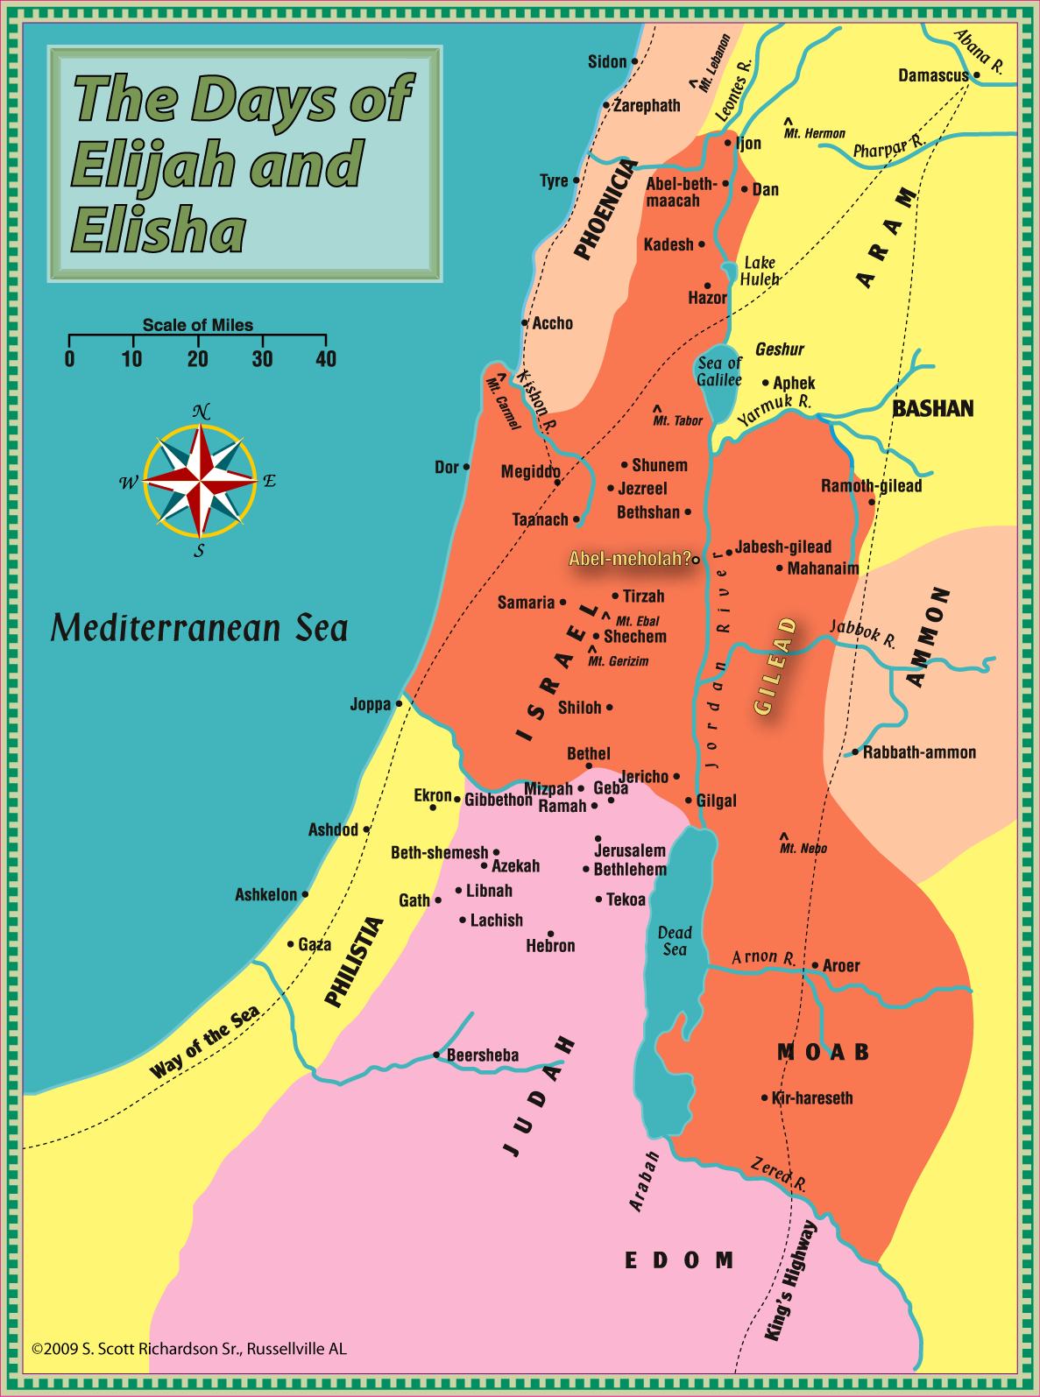
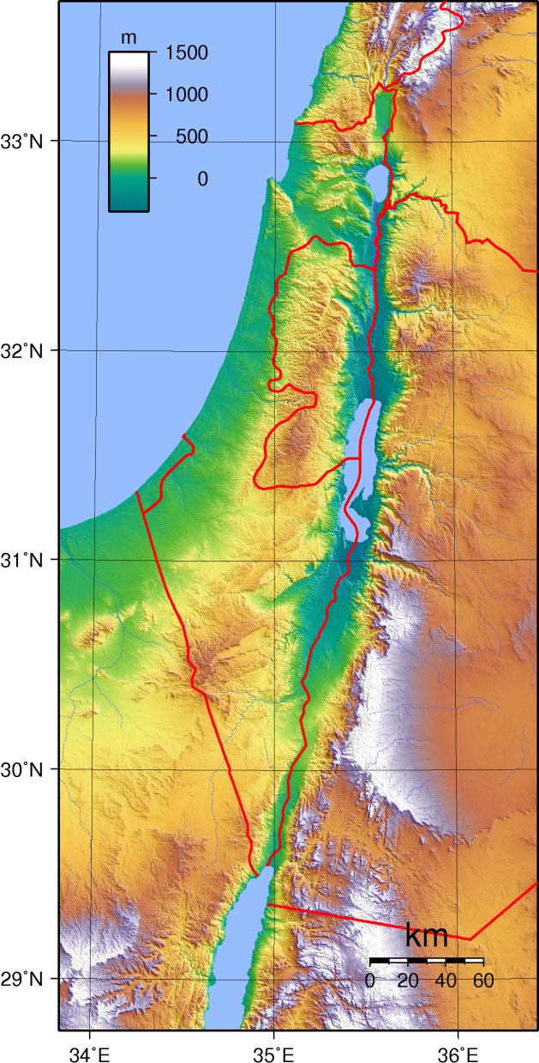

Slide 29
Elijah’s Insistence
The “hand of the Lord came upon Elijah”, and he “ran ahead of Ahab” and the rain storm Elijah promised (18:41-46).
Ran from Mt. Carmel to Jezreel, a distance of 17-20 miles.
Ran from Jezreel to Beersheba, about 90 miles.
Prays for death from God, but presses on!
Continues into the wilderness for 40 days on only 2 meals!!!
Presses on to Horeb, Mt. Sinai, total of 100 miles from Jezreel!
When questioned by God, boasts in his efforts, questions God.
Twice! … Even after God asked again His first question!
Elijah was convinced of his self-justification! He was insistent!
But, so was God insistent! …

Slide 30
Who Is This About?
And he said, “I have been very zealous for the LORD God of hosts; because the children of Israel have forsaken Your covenant, torn down Your altars, and killed Your prophets with the sword. I alone am left; and they seek to take my life.” (I Kings 19:14)
Elijah begins and ends his complaint with his self.
Could we become discouraged, because we are fixated upon ourselves?
If so, then God’s answer to Elijah should be instructive and ultimately comforting to us …

Slide 31
To The Work!
Then the LORD said to him: “¹Go, return on your way to the Wilderness of Damascus; and when you arrive, ²anoint Hazael as king over Syria. Also you shall ³anoint Jehu the son of Nimshi as king over Israel. And ⁴Elisha the son of Shaphat of Abel Meholah you shall anoint as prophet in your place. (I Kings 19:15-16)
Elijah’s work was still not finished (I Ki. 21:17-29; II Ki. 1:1-17).
Enigma: When we focus on others, especially serving God, we lose ourselves in His work, and our worries often fade away!
Although patient and supporting, eventually God expects us to trust and obey (Job 38-42; Hab. 3:16-19; Luke 7:16-30).
We control our emotions and reaction (Ezekiel 24:15-27).
Notes:
Much like with Job, God does not gush all over Elijah. God does not thank Elijah for his sacrifice. In fact, He does not even acknowledge it. He is simply returned back to the work …

Slide 32
Generational War
Then the LORD said to him: “… It shall be that whoever escapes the sword of ¹Hazael, ²Jehu will kill; and whoever escapes the sword of Jehu, ³Elisha will kill. (I Kings 19:17)
God already saw and planned to judge Ahab and his house.
However, God would not accomplish it has Elijah expected.
Justice would be accomplished in 3 successive waves.
Are we irreplaceable? Does everything depend upon us?
God refines His workmen and teaches them the true source of their strength and the battle, God Himself.
“God buries His workmen, but His work continues.” - Coffman
Notes:
One source of Elijah’s discouragement was the unshakable reign of Jezebel and Ahab. They epitomized, led, and were ultimately responsible for Israel’s rejection of God and slaughter of His prophets. Although it appeared as if they were going to succeed, God let Elijah know that they would not succeed. Instead they would be wiped out.
But, they would not be wiped out instantly. There would be 3 successive waves of people diminishing Ahab’s house until it was eventually wiped out. Again, God does not always work in the way we want or expect.
No doubt Elijah was personally tired and very alone. God provides relief in a successor.
To some extent, Elijah expected lasting success and undeniable victory in His time. God corrects this misconception and unjustified expectation by pointing to future generations, who will continue the work. As Coffman said, “God buries His workmen, but His work continues.” No man is irreplaceable. We are not the heroes of this story. It is only by giving up all hopes of glory not due us that we can eventually receive the glory that suits us and which God wants us to have. He will refine His workmen, and thanks be to God for that.

Slide 33
All Alone? No One Left?
“Yet I have reserved seven thousand in Israel, all whose knees have not bowed to Baal, and every mouth that has not kissed him.” (I Kings 19:18)
Things are rarely quite as bad as they appear.
Like Elijah, too quickly we forget the faithful companions that surround us – many working unseen and unknown to us.
There may always be saints unknown to us – a remnant, suffering and withstanding just like us (Romans 11:2-5).
Notes:
Lastly, Elijah was not alone. First of all, we always have God. But, second of all, there will always be people, who are unknown to us but known to God. There are more people still faithfully serving God than we may ever know this side of eternity. Don’t let paranoia deceive you into thinking you are alone or have been abandoned.

Slide 34
The Remnant
God has not cast away His people whom He foreknew. Or do you not know what the Scripture says of Elijah, how he pleads with God against Israel, saying, “LORD, they have killed Your prophets and torn down Your altars, and I alone am left, and they seek my life”? But what does the divine response say to him? “I have reserved for Myself seven thousand men who have not bowed the knee to Baal.” Even so then, at this present time there is a remnant according to the election of grace. (Romans 11:2-5)
Even as it was for Elijah, so it was for Paul, and so it will be for us.
Don’t give up on God or His remnant! Don’t let paranoia win!
Do not let yourself be deceived into thinking you are alone.

Slide 35
Never Alone
At my first defense no one stood with me, but all forsook me. May it not be charged against them. But the Lord stood with me and strengthened me, so that the message might be preached fully through me, and that all the Gentiles might hear. And I was delivered out of the mouth of the lion. And the Lord will deliver me from every evil work and preserve me for His heavenly kingdom. To Him be glory forever and ever. Amen! (II Timothy 4:16-18)
Let your conduct be without covetousness; be content with such things as you have. For He Himself has said, “I will never leave you nor forsake you.” So we may boldly say: “The LORD is my helper; I will not fear. What can man do to me?” (Hebrews 13:5-6; see also, John 16:32)

Slide 36
Elijah’s Humility & Faith
So he departed from there, and found Elisha the son of Shaphat … (I Kings 19:19)
Elijah had show incredible persistence and even self-justification in his despair.
The Lord never congratulated, consoled, or coddled him.
However, God did answer, comfort, and strengthen Elijah!
Despite his tremendous insistence, Elijah humbly accepted the Lord’s answer, walked onward by faith, and obeyed!
If we get bent out of shape, will we humbly accept the correction of the Lord and our brothers? Trust and obey?
Notes:
There was a subtle rebuke and teaching moment for Elijah in God’s response. Elijah humbly received it, and although he may or may not have understood all the implications of what God told and showed Him, He mastered the main lesson: Trust and Obey.

Slide 37
Conclusion
Good - even great – men may become discouraged, like Elijah.
Draw comfort and hope from their example, if we are willing.
Let God determine “enough”. Pray, trust, submit, and serve.
Rejoice in God’s longsuffering, sympathetic patience.
Understand God may not conform to our expectations.
Allow God and brethren to persist with us in our insistence.
Turn our focus and demands from our happiness to God’s work!
Realize, we are part of a bigger war to be concluded after us.
Thank God and rejoice that we are never alone! Thank Him for His remnant and His promise to always remain with us.
Grow unto greatness through humility, faith, and obedience!

